Slide 1
What Changes with Windows 10 20H2
CAMUG
November 16, 2020

Slide 2
Windows 10 20H2
Are we there yet? How many are already updated?
Is it a big update? No! Not a lot has changed (and that’s a good thing – less to go wrong)
How long does it take to update? My desktop took about 2 minutes to update from 2004 If your system is earlier than 2004, it will be a big (long) update!
So, if it is small and quick, what changes?

Slide 3
Windows 10 20H2
The first thing to notice is the name change: Now called 20H2, instead of 2010
20H2 includes the new Chromium-based Edge browser You may have already installed this before 20H2 The old Edge browser is gone (replaced)

Slide 4
Windows 10 20H2 – Windows Shell
With this release, the solid color behind tiles on the Start menu is replaced with a partially transparent background. Tiles are also theme-aware.
Icons on the Start menu no longer have a square outline around each icon.
Notifications are slightly updated in appearance.
You can now change the monitor refresh rate on advanced display settings.
Alt+Tab now shows Edge browser tabs by default. You can edit this setting under Settings > System > Multitasking: Alt+Tab.

Slide 5
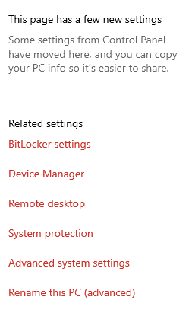
Windows 10 20H2 – Windows Shell
The classic “System” page in the Control Panel has been removed. When you try to open it, you’ll be taken to the About page in the new Settings app.
Links have been added to:
Device Manager,
Remote desktop,
System protection,
Advanced system settings,
Rename this PC
At this point, these are links to the old “Control Panel” tabs, not new panels!

Slide 6
Windows 10 20H2 – Windows Shell
There’s a convenient “Copy” button to copy all the text to your clipboard

Slide 7
Windows 10 20H2 – Windows Shell
There’s a convenient “Copy” button to copy all the text to your clipboard

Slide 8
Windows 10 20H2
Microsoft is expanding the “Your Phone” app with more features designed for “select Samsung devices.”
If you have one of these phones, you can now access your phone’s Android apps directly on your Windows 10 PC.
They’ll be running on your phone but you can launch, see, and interact with them on your Windows 10 desktop.

Slide 9
Windows 10 20H2
When you detached a keyboard on a 2-in-1 device, a notification popped up and asked you if you wanted to enable tablet mode.
Now, Windows will automatically switch to the new tablet experience added in the May 2020 Update without the prompt or notification.
You can change what happens—for example, to prevent Windows 10 from entering tablet mode automatically—by heading to Settings > System > Tablet.

Slide 10
Windows 10 20H2
Notification enhancements: Windows 10’s notifications now include an application logo so you can easily see which application generated them and an “x” button so you can quickly dismiss them.
Default taskbar icon tweaks: In a minor change, Windows 10 will adjust the default taskbar icon layout depending on what you use your PC for. If you link an Android phone during setup, you’ll see a Your Phone icon on the taskbar. If you have an Xbox Live account and you’re using a gaming PC, you’ll see an Xbox icon on the taskbar. You can still add or remove whatever icons you like.

Slide 11
Windows 10 20H2
That’s it!
Questions?

