Slide 1
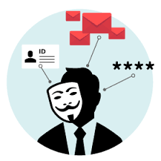
Spam, Phishing, and Social Engineering
CAMUG
Presented by Jan Bredon
May 17th, 2021

Slide 2
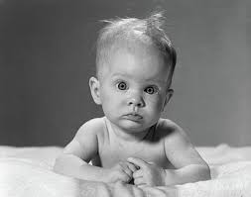
Is buttcheeks one word?
Or should they be pulled apart?

Slide 3
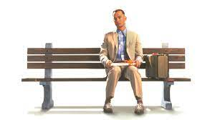
What is Forrest Gump’s password?

Slide 4
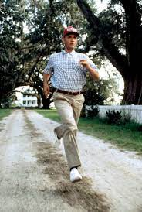
What is Forrest Gumps password?
1Forrest1 for 50 Points
or
14S1 for 100 Points

Slide 5
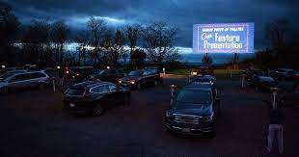
And now the movie folks …….

Slide 6
Domain Names a Review
CAMUG.com (same as camug.com)
myCAMUG.com is a different domain (not us)
CAMUGcom.com different domain (not us)
DNS Root Servers – Domain Name Servers
camug.com 34.224.160.149
www.camug.com 34.224.160.149
ftp.camug.com 34.224.160.150 (example)
www.camuq.com 37.187.137.134

Slide 7
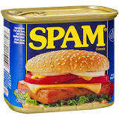
SPAM What Is It?
A Versatile Canned Meat Product?
Spiced Ham
Unsolicited Email
The name comes from a Monty Python sketch in which the name of the canned pork product SPAM is ubiquitous, unavoidable, and repetitive.[
Usually harmless, just irritating, and impossible to stop.

Slide 8
SPAM Why Me?
Signed up with a vendor for something.
Remember that funny email that you got?
You forwarded it to a friend
Who forwarded it to a group of friends
Who each forwarded it to a group of friends
Et ad infinitum (To infinity and beyond)
Who sent it to a SPAM FARMER
Who harvested all of those free email addresses.
Be a Friend – Delete the email addresses and BCC!

Slide 9
SPAM How to Stop It
UNSUBSCRIBE
If it works cool
If it doesn’t work you have just verified as Valid
Your email provider does some filtering
Folder called SPAM or maybe Junk
Check them, may contain good emails
Add a filter rule that deletes
Make sure your filter is unique to this item.
Have a separate Vendor email address.

Slide 10
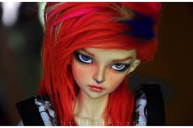
Phishing SPAM with ATTITUDE
Much more sophisticated type of SPAM
Wants to get a quick reaction from You
Offers personal Reward
You are due an IRS refund.
Threatens service discontinuation
Your Netflix account is being suspended
Your Grandchild has been arrested (picture)
Account Past Due (Electric, Gas, etc.)
Unclaimed Funds soon to be forfeited.

Slide 11
Phishing STOP
S - Suspicious?
T - Telling me to click a link?
O - Offering something amazing?
P - Pushing me to act fast?
NEVER CLICK ON A LINK IN AN EMAIL,
OR IN A TEXT.
IF YOU JUST HAVE TO DO IT!
Check the LINK and DOMAIN

Slide 12
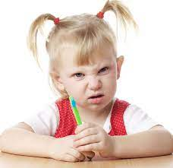
Phishing Hyperlinks
A Hyperlink has two pieces to it …
The display text that you see
Click on me to go to your Bank Account.
The Link portion that sends you somewhere.
Looks like my Bank’s Sign In Page
Username
Password
Just the fact that you clicked on the link tells someone that they got the Bank name right.
Hyperlinks are convenient, but can be deadly

Slide 13
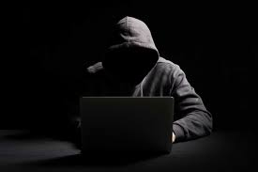
Phishing Hackers
In Putting this presentation together
Saw a Hacker Self Service Site
Menu .. Choose Your Target Business
Provide the Hacker Email address to receive the data
Select the size of your target group (How much $)
Checkout and Pay and Download the Generator.
You receive a look-a-like urgent email from the Target Business.
You click the link, They politely send you to the look-a-like website, collect your username and password, then forward and log you in to the real website. You are not aware.
Your Hacker gets an email with Business name and your credentials.

Slide 14
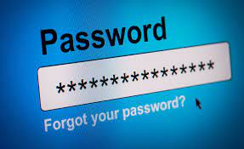
Social Engineering Passwords
All of the Computer Security in the World is no good if You just give them the information they need to Hack Your Account
Password
Personal – (child or pet or curse word )
Must have a Capital Letter (Child, Pet, Curse)
Must have a number (Child1, Pet1, Curse1)
Must have a Special Character (We all added !)
Passwordssssssssssssssss

Slide 15
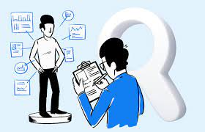
Social Engineering Personal Info
What are these?
Mothers Maiden Name
Birthdate
First Pet’s Name
Grade School
First Car
Street You Grew Up On

Slide 16
Social Engineering Websites
Facebook
Birthdate so everyone can say Happy Birthday
Anyone else from Greentown Grade School?
Who likes Camaro’s?
You comment “My first car was a Blue 68 Camaro”
What was your first Dog?
You Comment “I had a Black Lab named Shadow.”
Innocent comments that are collected and mined.

Slide 17
Social Engineering Phone Calls
Unknown Caller - Do not answer, let leave a msg
Remember they have your number, you NOT theirs
Microsoft Support – No!
IRS – No!
Your Bank – No!
Clerk of Courts – No!
“Shut Up and Hang Up”
(or simply don’t answer)

Slide 18
Social Engineering Your Family
Educate everyone in your family
They all have Social Media Accounts
They all try to be friendly and helpful
They give away their information freely
Location info on photo
Photo descriptions
They don’t know what they don’t know.
Easy targets.
Click Happy!!

Slide 19
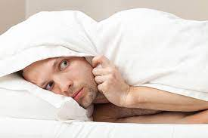
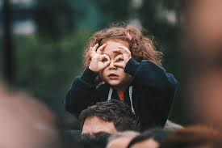
Social Engineering What can You do?
Be Alert
STOP Method
S - Suspicious?
T - Telling me to click a link?
O - Offering something amazing?
P - Pushing me to act fast?
Don’t click links in Emails or Texts
Don’t call phone numbers in Emails or Texts
Type in the website name, Dial the Phone#
Two Part authentication is wonderful!
Do not use Admin Account for everyday.
Keep Current Backups (Offline)

Slide 20
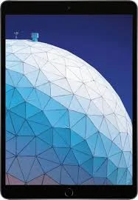
Social Engineering Giveaway Drawing
*** WIN A BRAND NEW IPAD ***
To Enter, Send me an email and list the following… (You have 5 minutes to enter)
Full Name
Birthdate
Place of Birth
Mother’s Maiden Name
Address where to mail Your New Ipad.
LucieLove1@gmail.com
REMEMBER ONCE IT IS GONE YOU CAN NOT GET IT BACK

